Slide 1


Slide 2
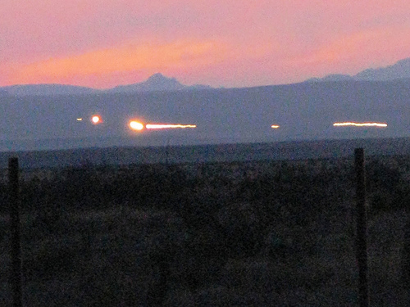

Slide 3
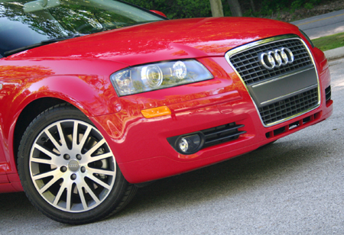
Car headlights

Slide 4
